Slide 1
Markage
Kelompok 25

Slide 2
members
Kevin Raihan
Fabio Rabbani
Yoel Dwi Miryano

Slide 3
Outline
Background
Purpose
UML
Flowchart
ERD
Features
Backend
Frontend
Database
Documentation

Slide 4
BAckground
Market Manager
JavaScript, React JS, dan PostgreSQL
Pertumbuhan volume data semakin cepat dan akurat
Mengembangkan sistem pengelolaan market yang lebih efektif

Slide 5
purpose
Memenuhi kebutuhan pengelola pasar
Otomatisasi dan penyederhanaan
System assisted management

Slide 6
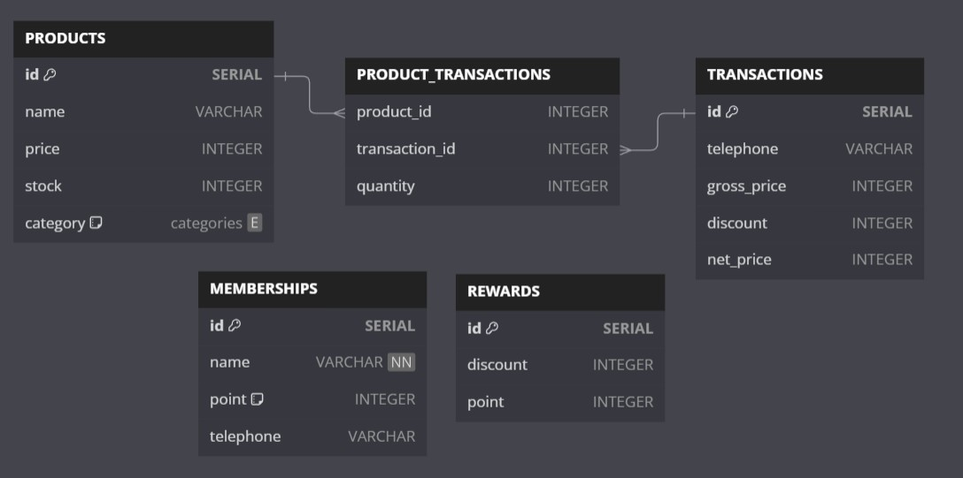
UML

Slide 7
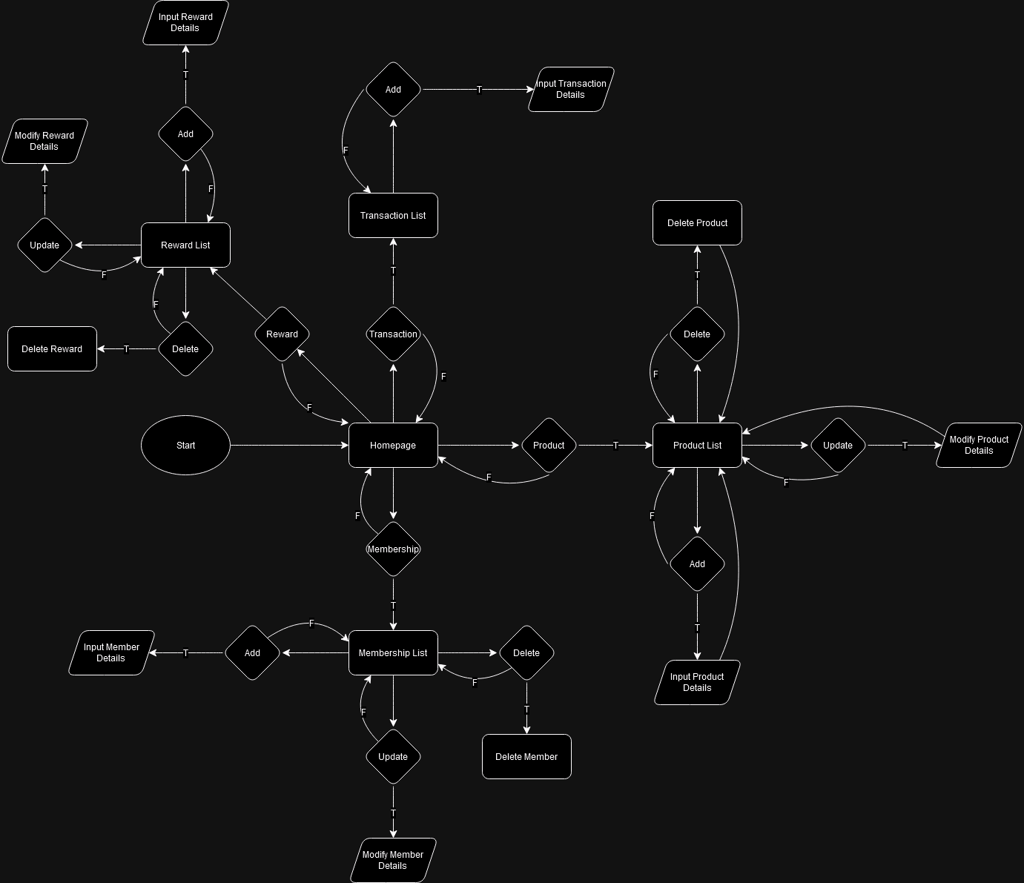
FlowChart

Slide 8
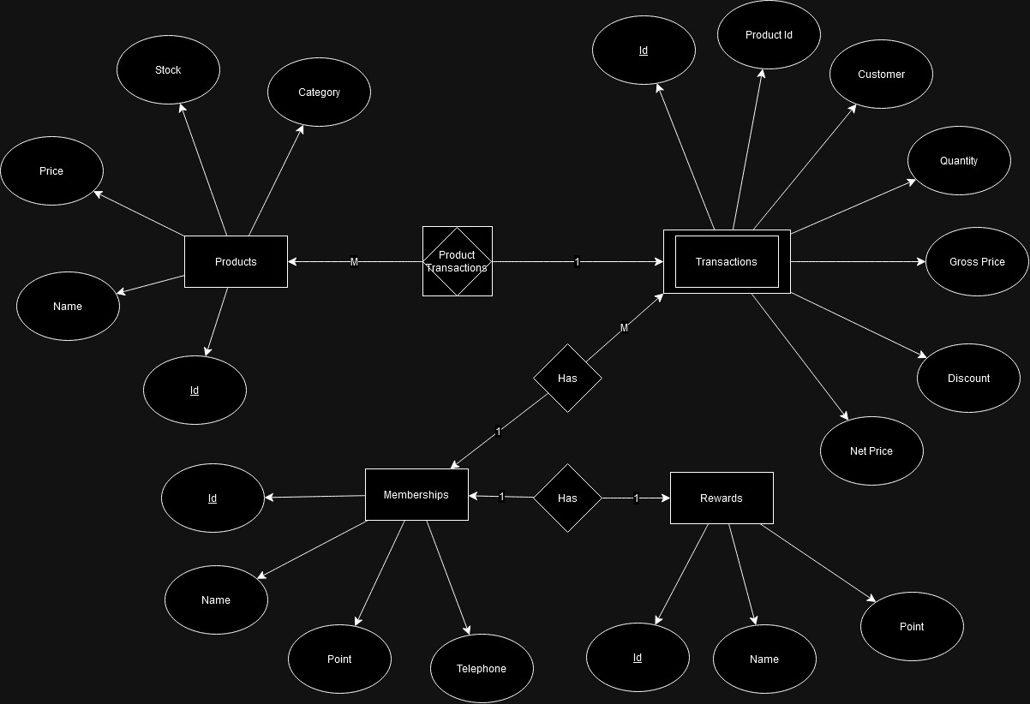
erd

Slide 9





Features
backend | frontend | Database
JavaScript | React JS | PostgreSQL
Node JS | Browser | NeonDB

Slide 10




features
products
transactions
Memberships
rewards

Slide 11
backend
productController
transactionController
membershipController
rewardController
Routes
Connector
Index

Slide 12
products
getAllProducts
getProductByKey
getProductById
addProduct
updateProduct
deleteProduct

Slide 13
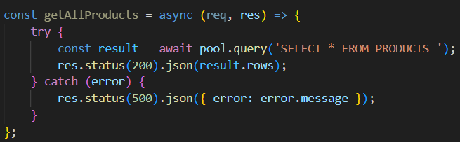
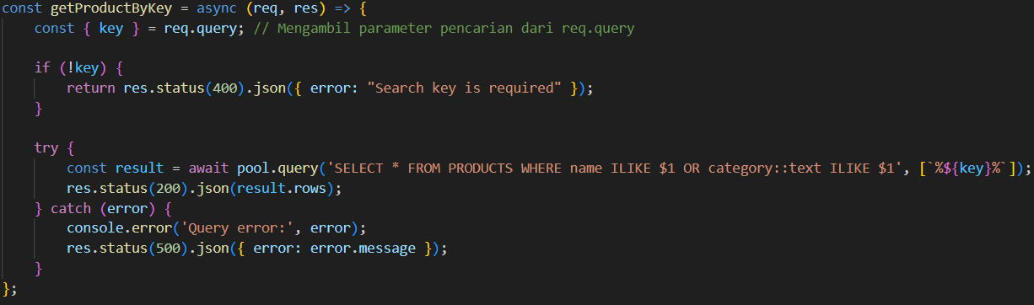
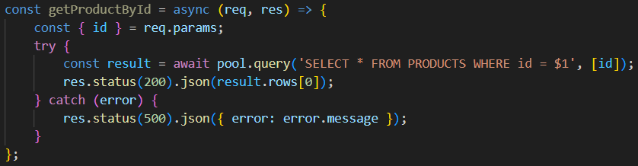
type | Source code
Get all
Get key
Get id

Slide 14
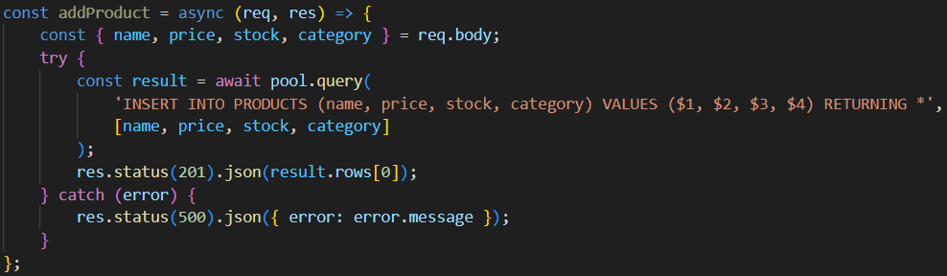
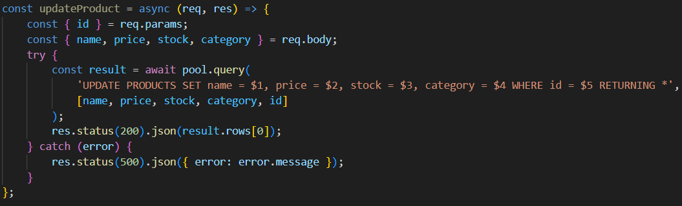
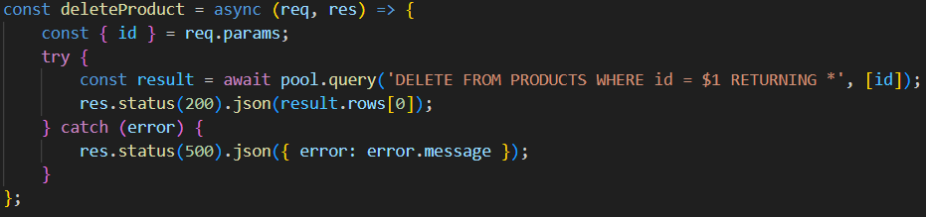
type | Source code
add
update
delete

Slide 15
transactions
getAllTransactions
getTransactionById
addTransaction

Slide 16
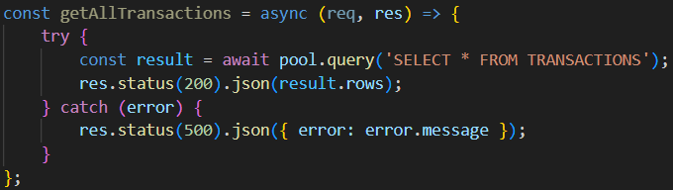
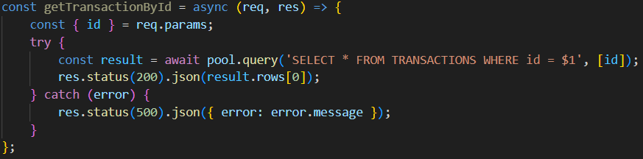
type | Source code
Get all
Get id
add | =>

Slide 17
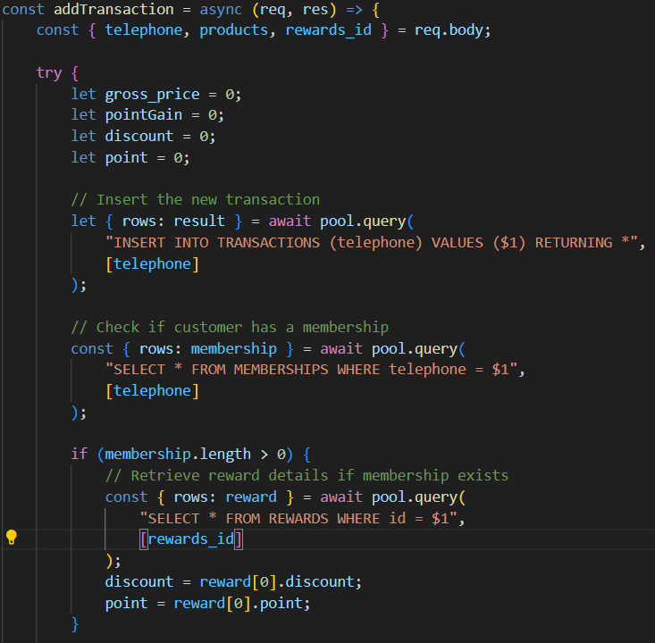
Add

Slide 18
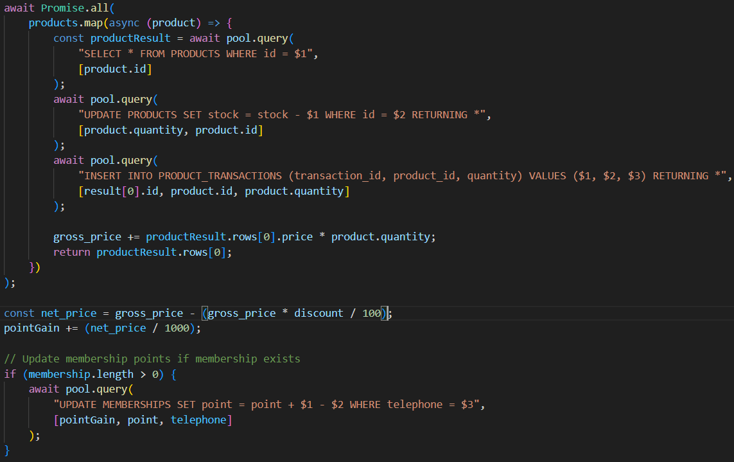
Add

Slide 19
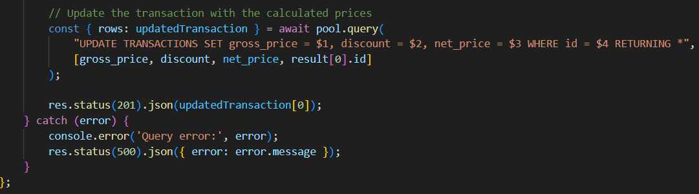
Add

Slide 20
memberships
getAllMemberships
getMembershipById
getMembershipByTelephone
addMembership
updateMembership
deleteMembership

Slide 21
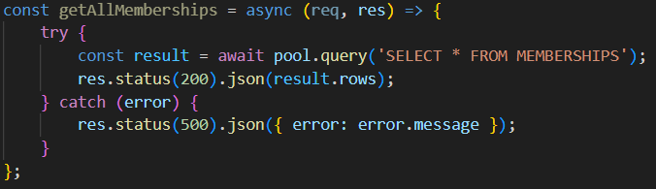
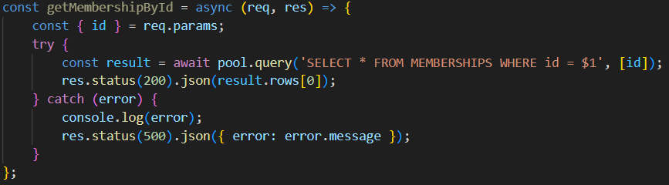
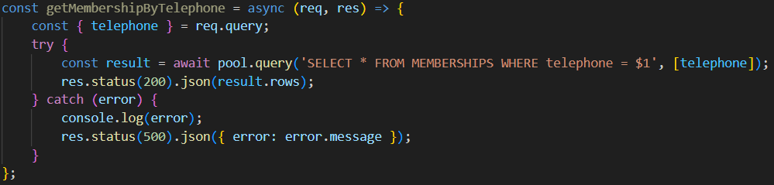
type | Source code
Get all
Get id
Get telephone

Slide 22
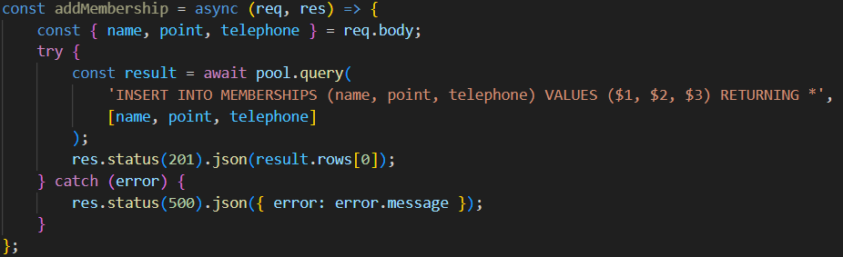
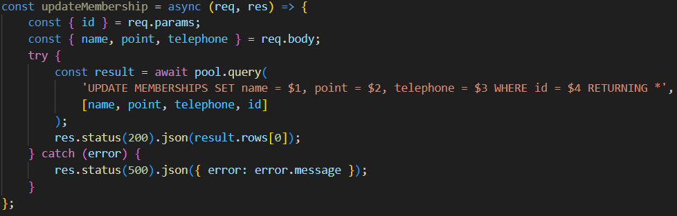
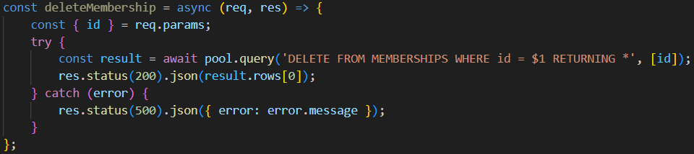
type | Source code
add
update
delete

Slide 23
rewards
getAllRewards
addReward
updateReward
deleteReward

Slide 24
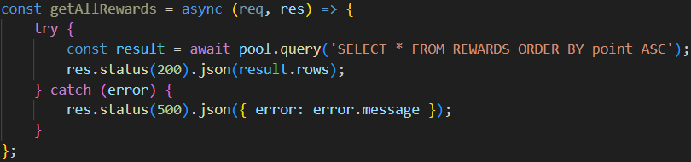
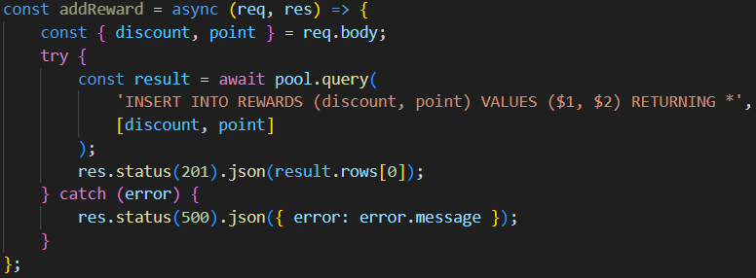
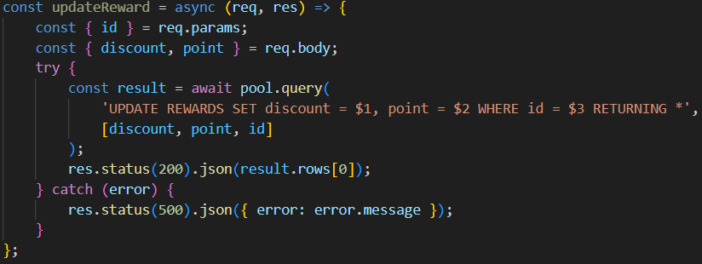
type | Source code
Get all
add
update

Slide 25
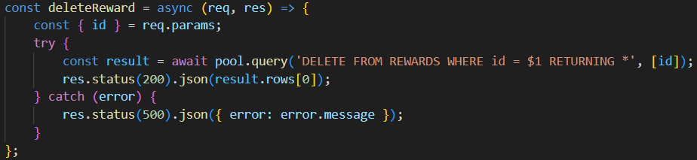
type | Source code
delete

Slide 26
routes
_routes
membershipRoute
productRoute
rewardRoute
transactionRoute

Slide 27
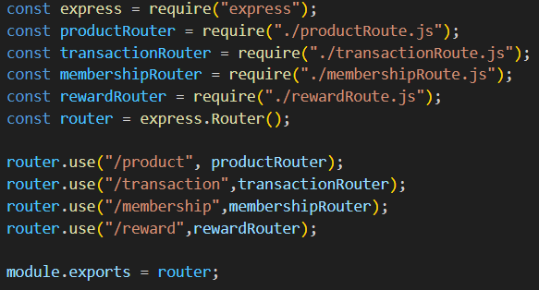
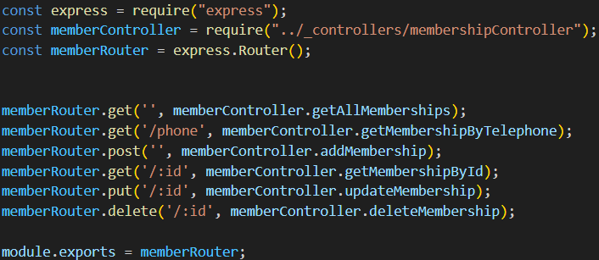
routes
membership

Slide 28
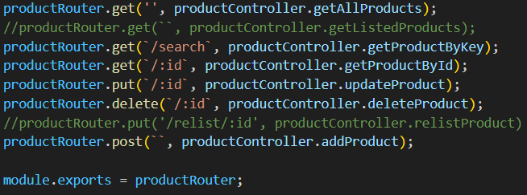
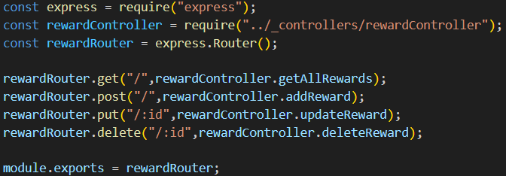
product
reward

Slide 29
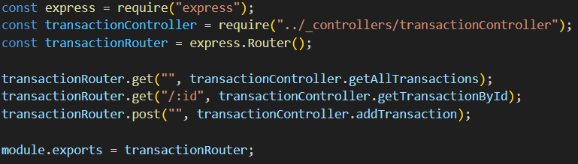
transaction

Slide 30
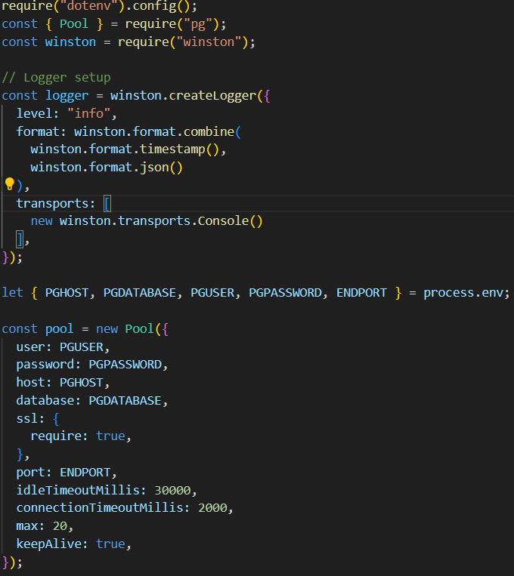
connector

Slide 31
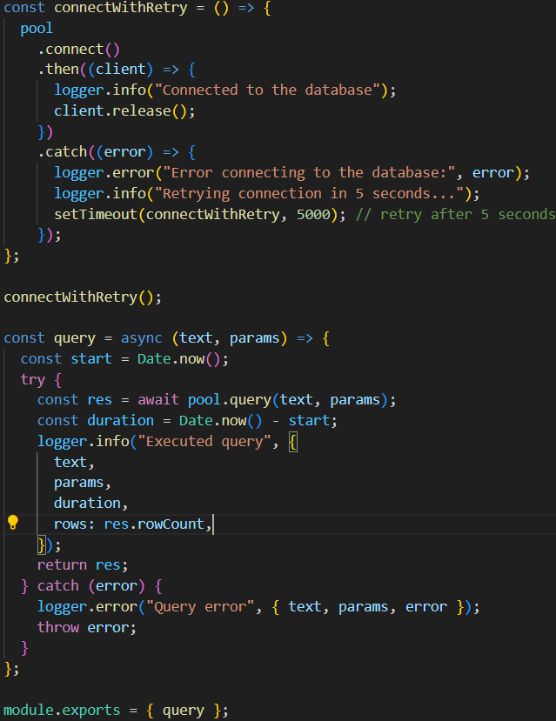
connector

Slide 32
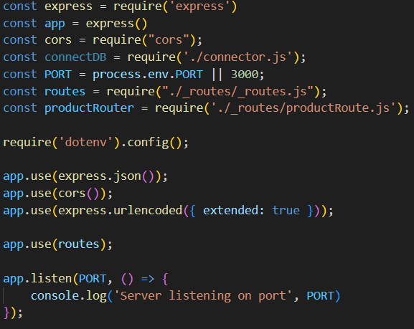
index

Slide 33
frontend
Homepage
AddMembership
AddProduct
AddReward
AddTransaction
EditMembership
EditProduct
EditReward
MembershipList
ProductList
RewardList
Transaction List

Slide 34
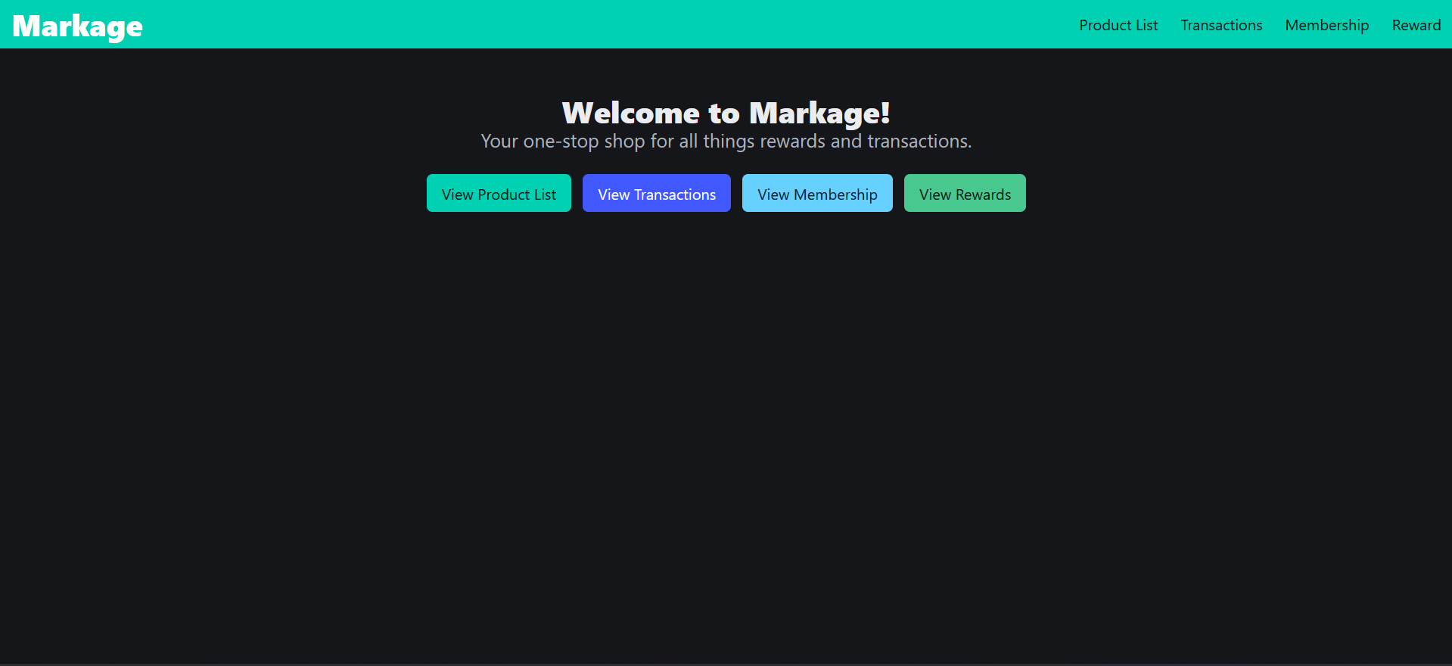
Homepage

Slide 35
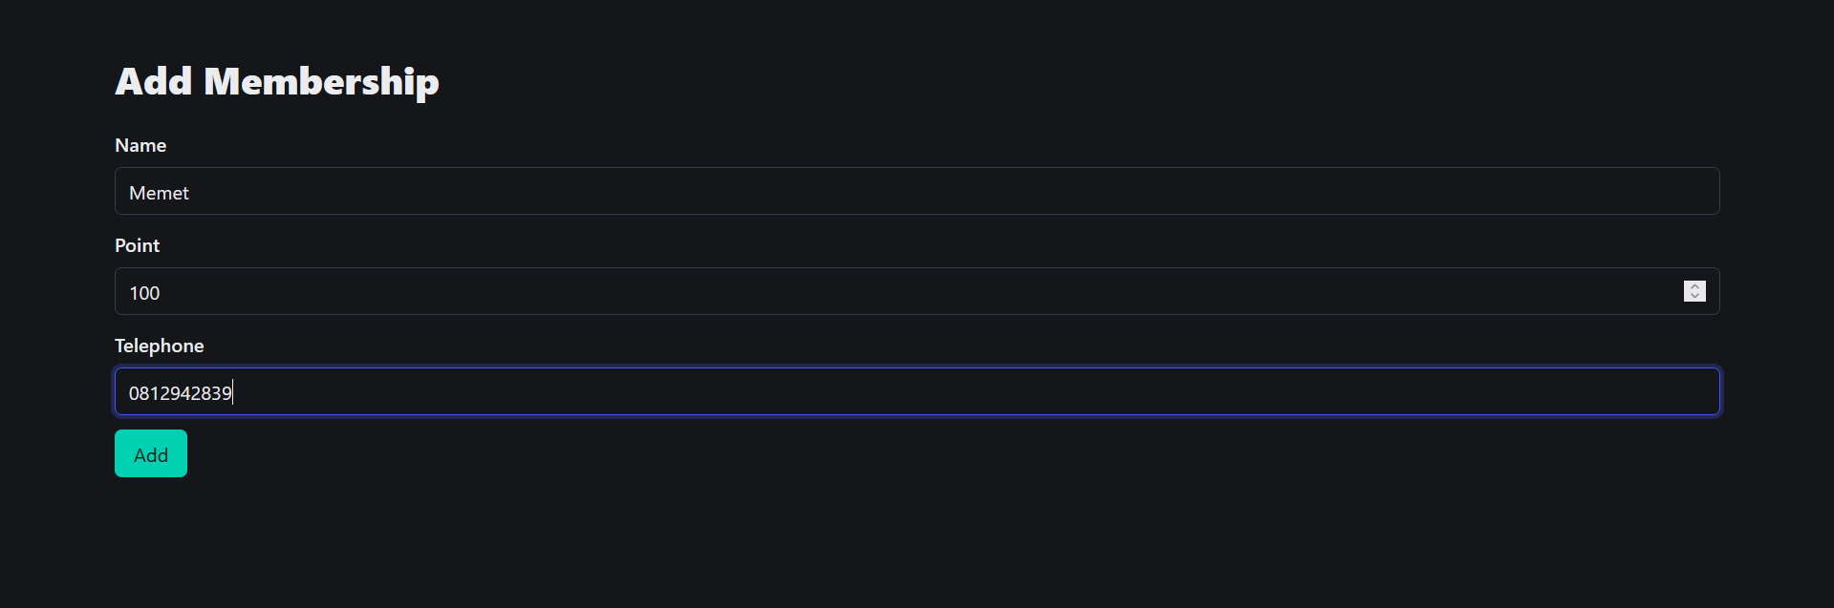
Add membership

Slide 36
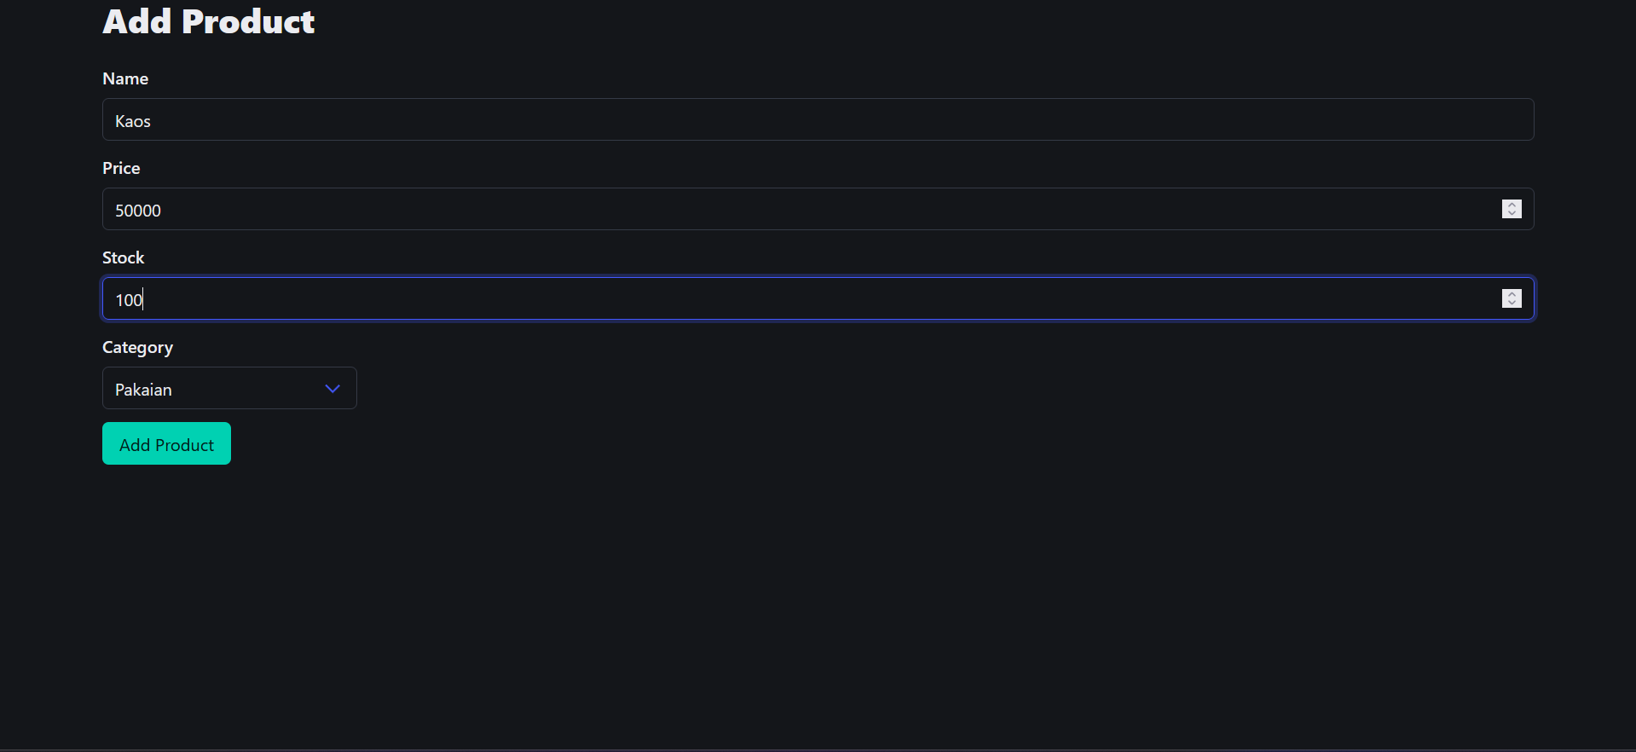
Add product

Slide 37
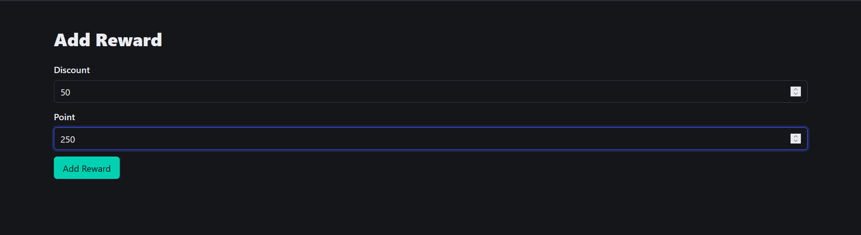
Add reward

Slide 38
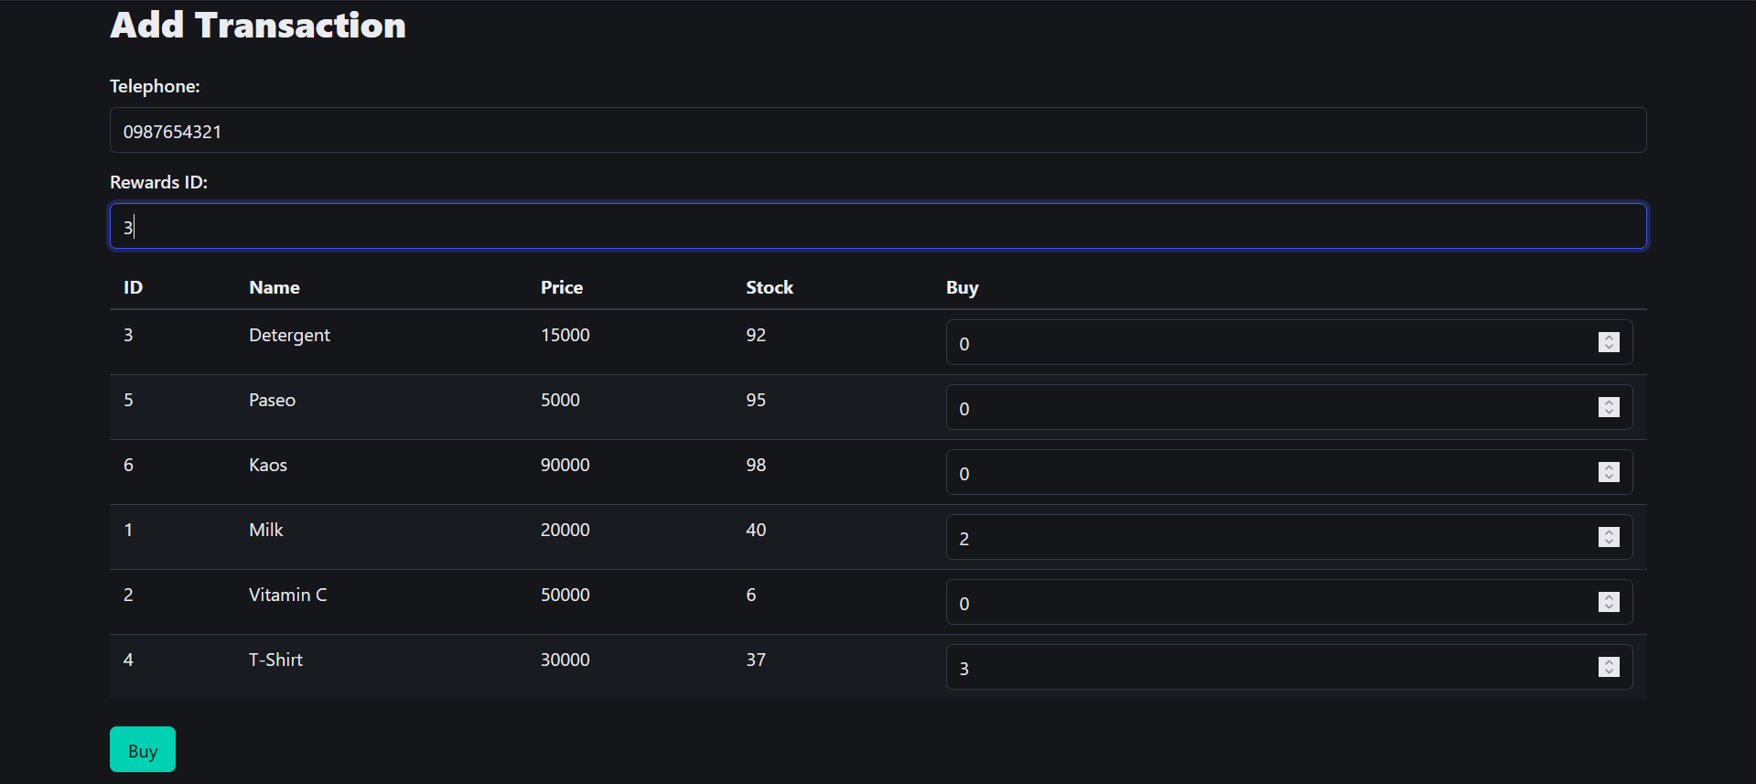
Add transaction

Slide 39
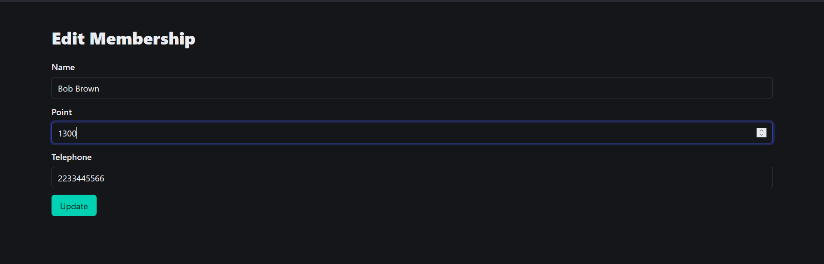
Edit membership

Slide 40
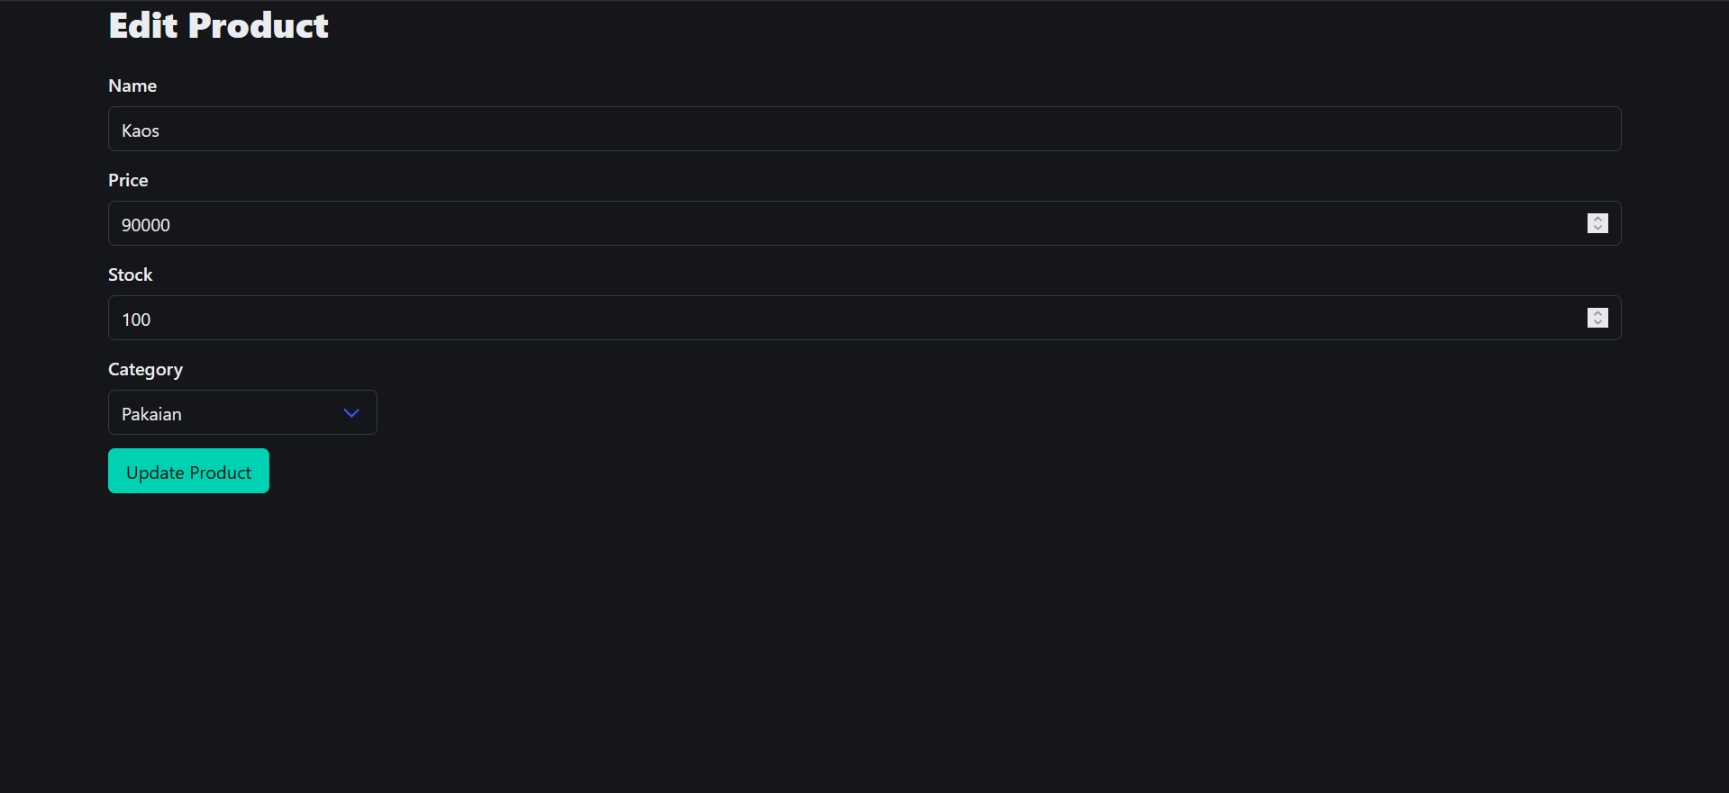
Edit product

Slide 41
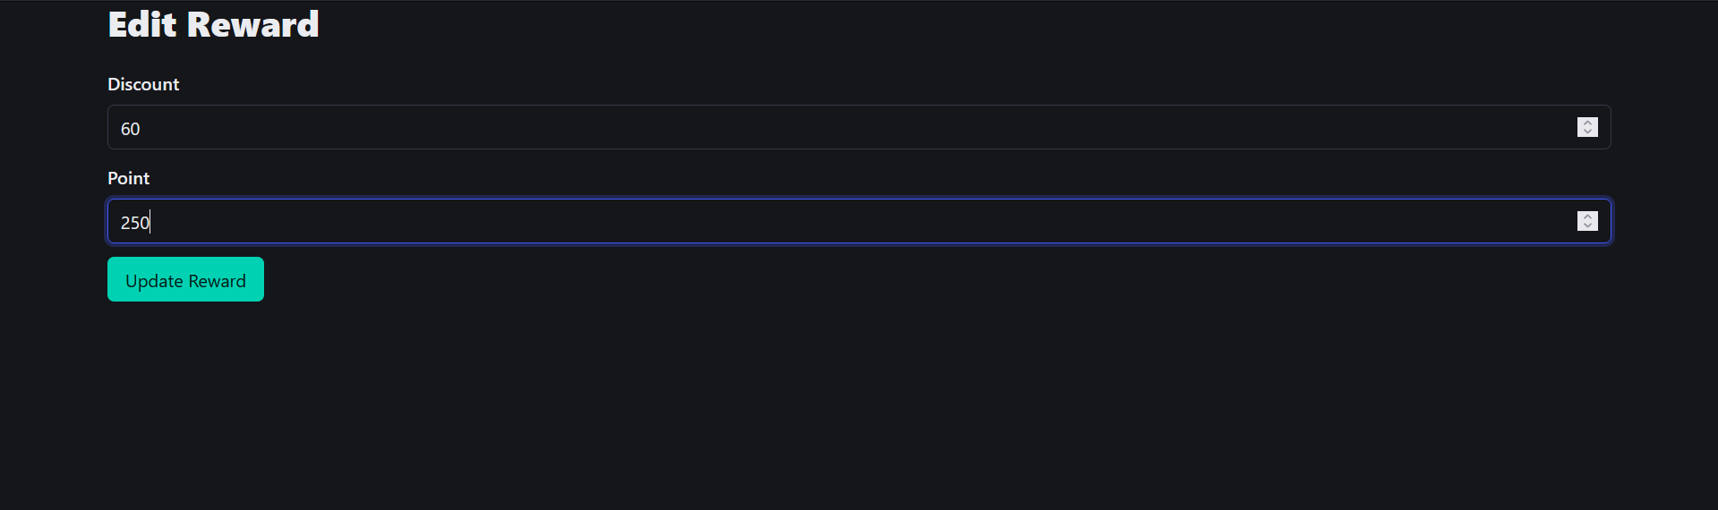
Edit reward

Slide 42
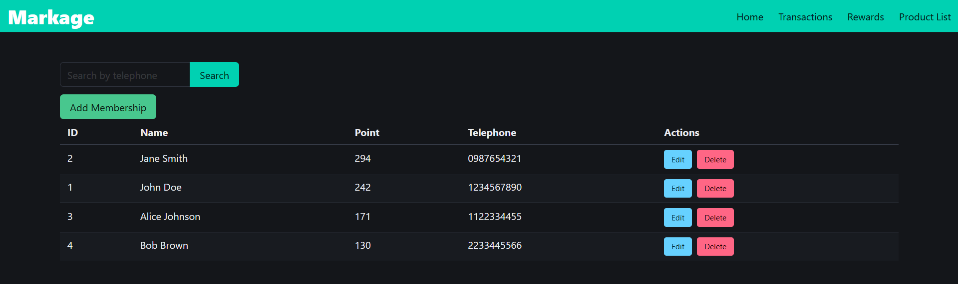
Membership list

Slide 43
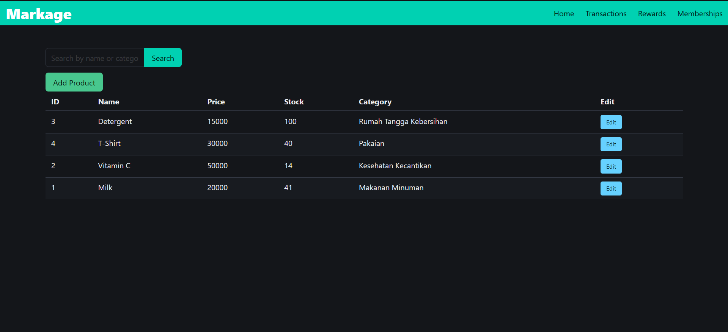
Product list

Slide 44
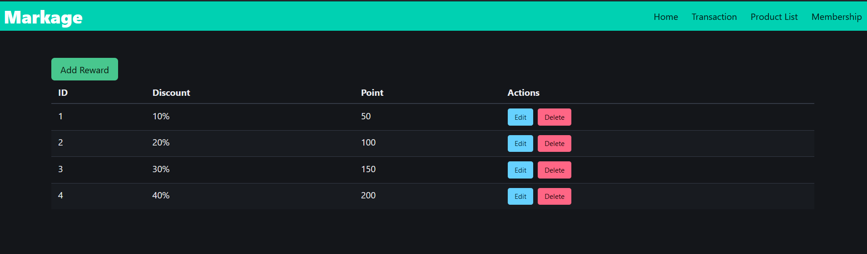
Reward list

Slide 45
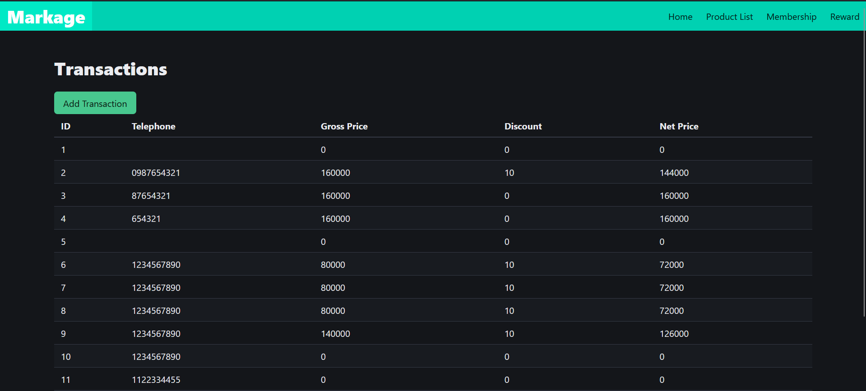
transaction list

Slide 46
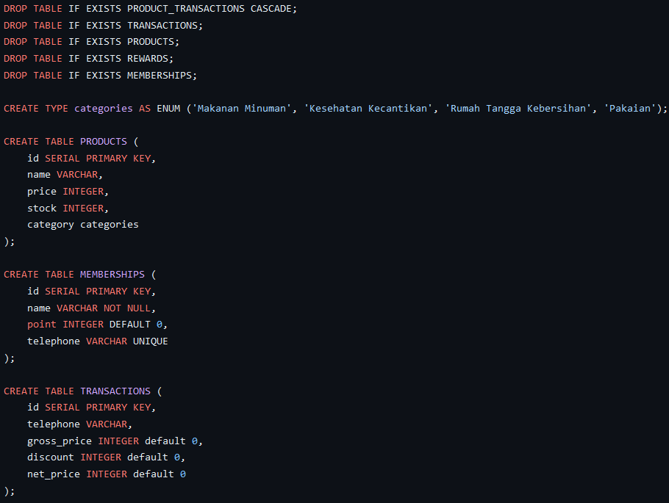
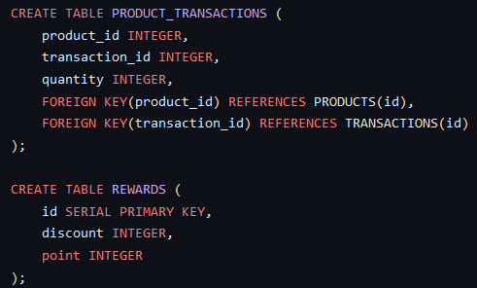
Database (POSTGRESQL)

Slide 47
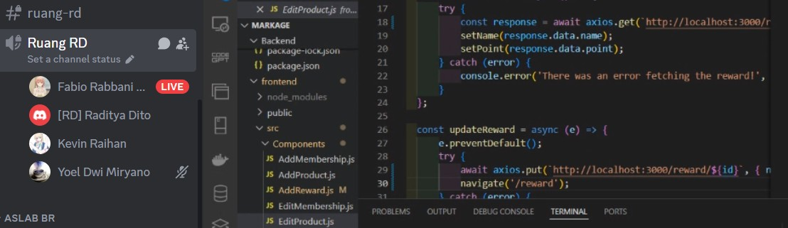
documentation

Slide 48
Thank you!

